Slide 1
WLAN Service Sets
Service set: all of the devices that are associated with an 802.11 WLAN
Three different WLAN service set configurations:
  Basic service set
  Extended service set
  Independent basic service set

Slide 2
Basic Service Set
Basic Service Set (BSS): Group of wireless devices served by single AP
  Basic Service Set Identifier (BSSID)
    Media access control (MAC) address of the AP
BSS must be assigned unique identifier
  Service Set Identifier (SSID)
    Serves as “network name” for BSS

Slide 3
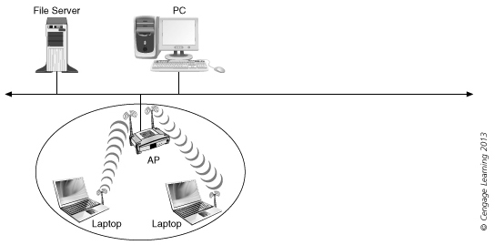
Basic Service Set (BSS)

Slide 4
Extended Service Set
Extended Service Set (ESS): Comprised of two or more BSS networks connected via a common distribution system
APs can be positioned so that cells overlap to facilitate roaming
  Wireless devices choose AP based on signal strength
  While moving, if a mobile device finds an AP with a stronger signal, the device associates with the new AP (process is called a handoff)

Slide 5
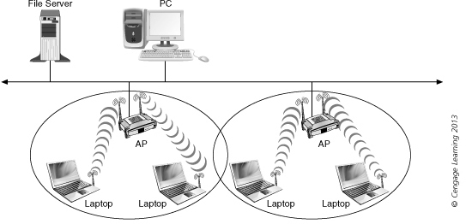
Extended Service Set (ESS)

Slide 6
Independent Basic Service Set
Infrastructure mode: wireless network that communicates through an AP
Independent Basic Service Set (IBSS): Wireless network that does not use an AP
  Wireless devices communicate between themselves
  Peer-to-peer or ad hoc mode
BSS more flexible than IBSS in being able to connect to other wired or wireless networks

Slide 7
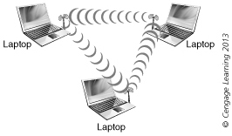
Independent Basic Service Set (IBSS)

Slide 8
802.11 Frame Types
There are three main types of 802.11 frames:
  Management frames
  Control frames
  Data frames

Slide 9
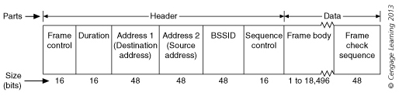
Management Frames
Management Frames: Initialize communications between device and AP (infrastructure mode) or between devices (ad hoc mode)
  Maintain connection
Management frame

Slide 10
Management Frames
Types of management frames:
  Authentication frame
  Association request frame
  Association response frame
  Beacon frame
  Deauthentication frame
  Disassociation frame
  Probe request frame
  Probe response frame
  Reassociation request frame
  Reassociation response frame

Slide 11
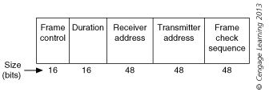
Control Frames
Control frames: Provide assistance in delivering frames that contain data

Slide 12
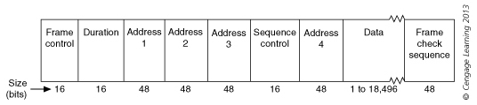
Data Frames
Data frame: Carries information to be transmitted to destination device

Slide 13
WLAN Operations
WLAN functions:
  Discovering a WLAN
  Joining the WLAN
  Transmitting on a WLAN

Slide 14
Discovering the WLAN
At regular intervals, AP (infrastructure network) or wireless device (ad hoc network) sends a beacon frame
  Announce presence
  Provide info for other devices to join network
  Process is known as beaconing
Beacon frame format follows standard structure of a management frame
  Destination address always set to all ones

Slide 15
Discovering the WLAN
Beacon frame body contains following fields:
  Beacon interval
  Timestamp
  Service Set Identifier (SSID)
  Supported rates
  Parameter sets
  Capability information
In ad hoc networks, each wireless device assumes responsibility for beaconing
In infrastructure networks beacon interval normally 100 ms, but can be modified

Slide 16
Discovering the WLAN
Receiving wireless device must be looking for beacon frames
Passive scanning: Wireless device simply listens for beacon frame
  Typically, on each available channel for set period
Active scanning: Wireless device first sends out a management probe request frame on each available channel
  Then waits for probe response frame from all available APs

Slide 17
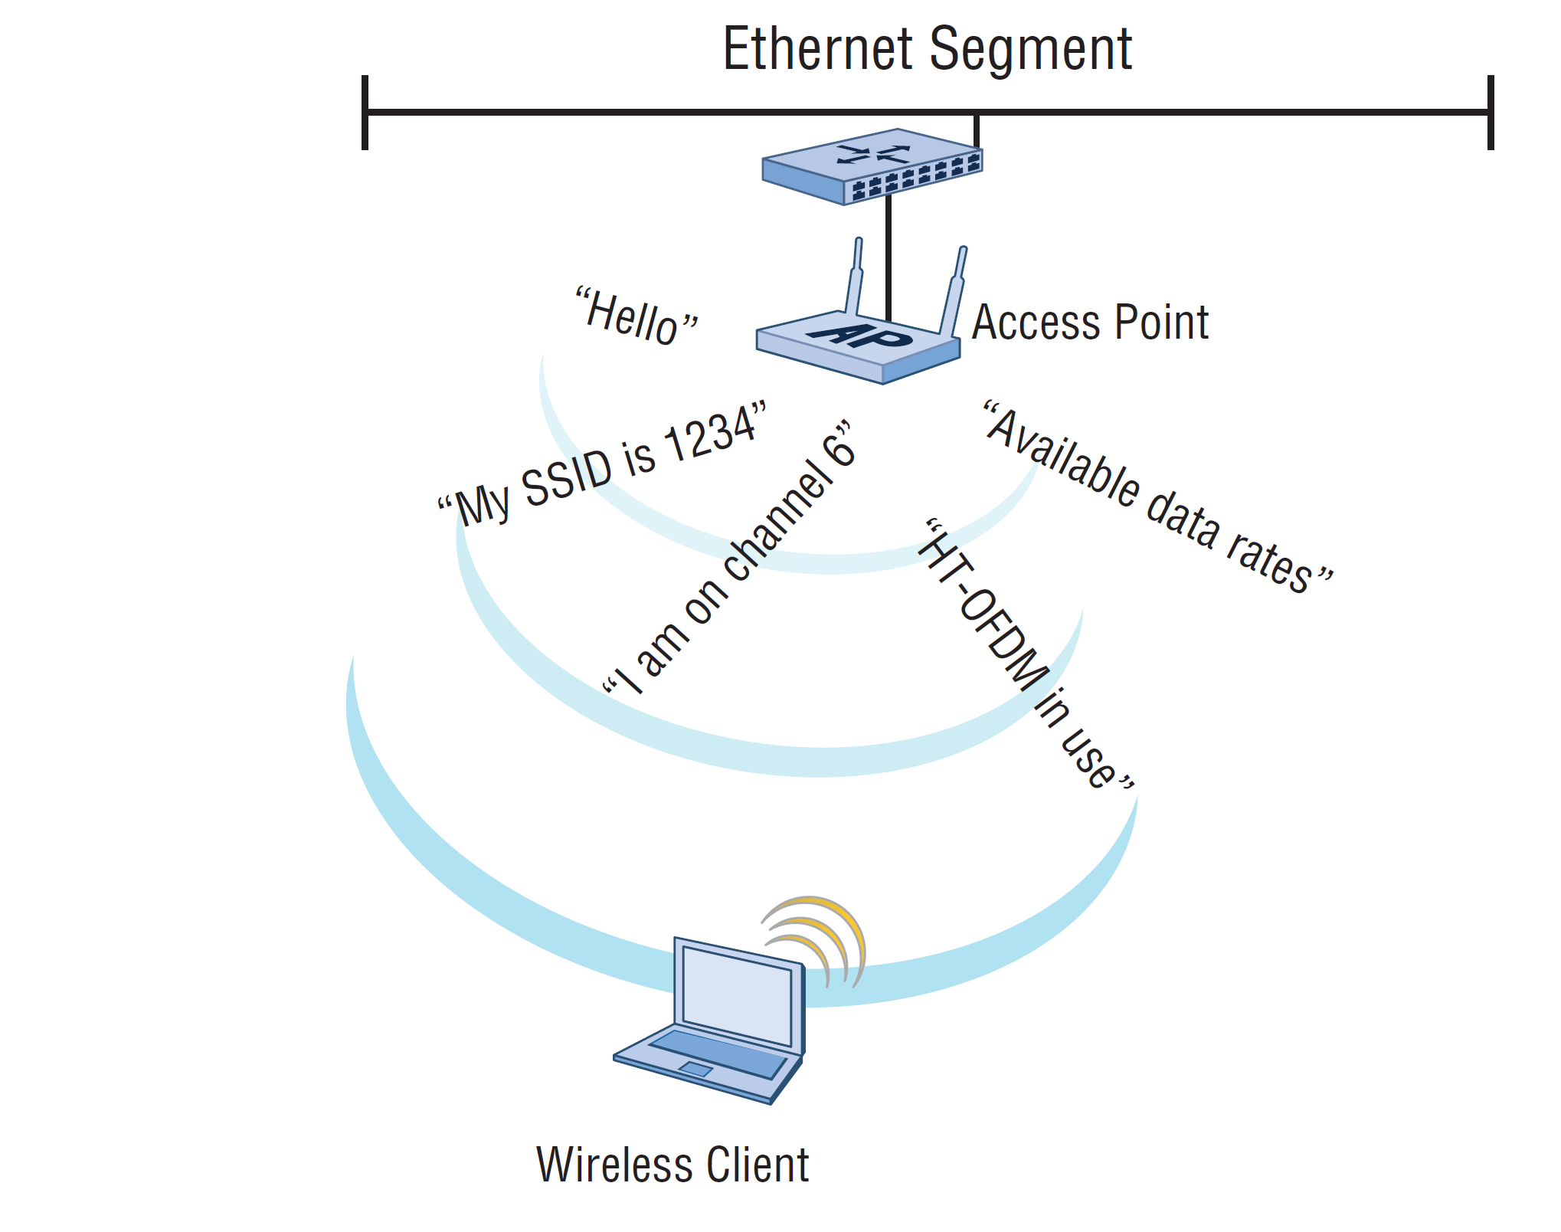

Slide 18
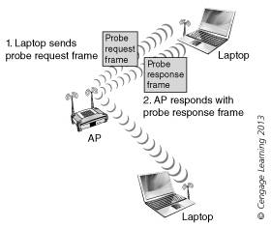
Active scanning

Slide 19
Joining the WLAN
Unlike standard wired LANS, authentication performed before user connected to network
  Authentication of the wireless device, not the user
IEEE 802.11 authentication: Process in which AP accepts a wireless device
Open system authentication: device sends an association request frame to an AP
  AP responds with an association response frame
  Virtually a “handshake” between the AP and device

Slide 20
Overview of WLAN Access
The process of joining a Wi-Fi network is as follows:
  The STA initiates the process by sending an association request to the AP.
  The AP then runs an authentication process. An association response is sent back to the STA if the authentication is successful.

Slide 21
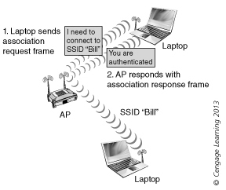
Open system authentication

Slide 22
Joining the WLAN
Shared key authentication: process of a station encrypting text in order to be accepted into the WLAN
  Utilizes challenge text
    Station encrypts text with a shared key value and send to AP
    AP decrypts text and compares with its own key value to see if it matches

Slide 23
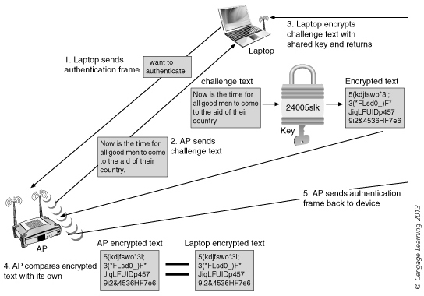
Shared key authentication

Slide 24
Evolution of WLAN Security

Slide 25
Wired Equivalent Privacy
WEP is a set of security schemes introduced as part of the original IEEE 802.11 wireless networking standard in September 1998.
WEP was intended to protect wireless confidentiality comparable with that of a traditional wired network.
It is also intended to achieve some other security goals such as access control and data integrity.
Although WEP has serious flaws and thus all the security goals are failed, it still shares some of the major design of more advanced security schemes, especially its successor, the WPA.

Slide 26
WEP Access Control
WEP provides access control or authentication to WLAN.
It requires an STA to be authenticated by the AP before association. The authentication process is
based on a simple challenge–response protocol.

Slide 27
WEP Security Problems
Problems in WEP Access Control
  The same shared secret key is used for both authentication and encryption
  A rogue AP may be set up
Problems in WEP Integrity
  Possible collision due to the simplicity of CRC-32
Problems in WEP Confidentiality
  Weak key

Slide 28
IEEE 802.1X Authentication Model
IEEE 802.1X standard was originally defined for IEEE 802.3 Ethernet in 2001.
It uses authentication server called a Remote Authentication Dial In User Service “RADIUS Server” to checks a user's credentials.
Depending on the network policies, grants users varying levels of access to the network.

Slide 29
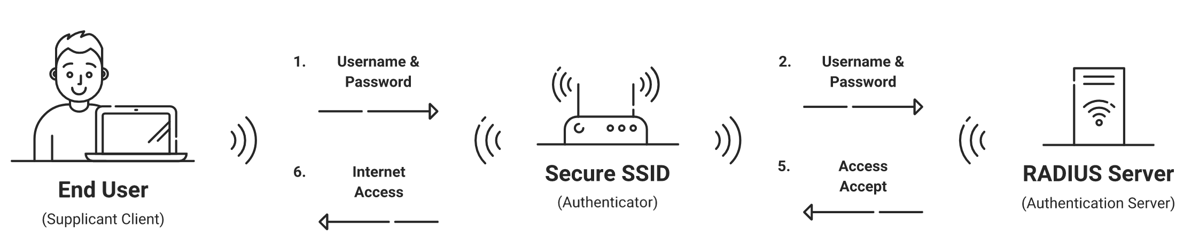

Slide 30
IEEE 802.11i Standard
The IEEE 802.11i standard defines two security protocols
Wi-Fi Protected Access (WPA)
  WPA was used as a temporary security enhancement for WEP
  An optional protocol Temporal Key Integrity Protocol (TKIP) to allow backward compatibility with WEP.
Wi-Fi Protected Access II (WPA2).
  AES is the chosen cryptographic algorithm for both confidentiality and data integrity

Slide 31
WPA
WPA has two different modes
  Enterprise Mode (WPA-EAP) It was used with Extensible Authentication Protocol (EAP) and because of this it was more secured. WPA Enterprise mode was needed an Authentication Server ”RADIUS Server”.
  Personal Mode (WPA-PSK) Pre shared keys was used with this mode. The implementation and management of this mode was easier.

Slide 32
WPA2
WPA2 also has two different modes Enterprise Mode (WPA2-EAP) and Personal Mode (WPA2-PSK)
WPA2 uses AES for encryption (Advanced Encryption Standard) had improved by United States Goverment.
WPA2 is vulnerable to Dictionary Attacks that is used to predict password with many different attempts.

Slide 33
WPA3
It is the last developed Security Standard for Wireless (Wi-Fi Protected Access 3). WPA3 offers improved authentication and encryption. It will be used more with 802.11ax standard and it will be become mandatory with Wi-Fi 6.
WPA3 also has two different modes Enterprise Mode (WPA-EAP) and Personal Mode (WPA-PSK)
It uses new technology called OWE (Opportunistic Wireless Encryption). It is developed for Public Networks to avoid Man In the Middle attack.
WPA3 offers QR Codes to connect the devices to the networks

Slide 34
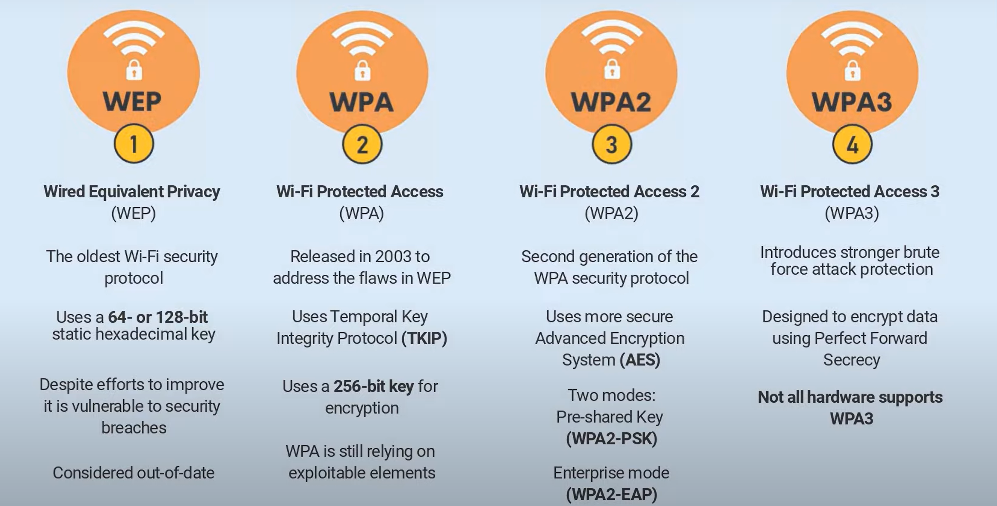

Slide 35
Joining the WLAN
Association: Accepting a wireless device into a wireless network
  Final step to join WLAN
After authentication, AP responds with association response frame
  Contains acceptance or rejection notice
If AP accepts wireless device, reserves memory space in AP and establishes association ID
Association response frame includes association ID and supported data rates

Slide 36
What is a Site Survey?
When installing a WLAN for an organization, areas of dead space might not be tolerated
  Ensure blanket coverage, meet per-user bandwidth requirements
Factors affecting wireless coverage goals:
  Devices emitting RF signals
  Building structure (walls, construction materials)
  Open or closed office doors
  Stationary versus mobile machinery/equipment

Slide 37
What is a Site Survey?
Factors affecting wireless coverage goals (continued):
  Expansion of physical plant or growth of organization
  Existing WLANs
    Both inside organization, and within nearby organizations
Site survey: Process of planning a WLAN to meet design goals
  Effectiveness of a WLAN often linked to thoroughness of the site survey

Slide 38
Purpose of a Site Survey
Design goals for a site survey:
  Achieve best possible performance from WLAN
  Certify that installation will operate as promised
  Determine best location for APs
  Develop networks optimized for variety of applications
  Ensure coverage will fulfill organization’s requirements
  Locate unauthorized APs

Slide 39
Purpose of a Site Survey
Design goals for a site survey (continued):
  Map nearby wireless networks to determine existing radio interference
  Reduce radio interference as much as possible
  Make wireless network secure
Survey provides realistic understanding of infrastructure required for proposed wireless link
  Assists in predicting network capability and throughput
  Helps determine exact location of APs and power levels required

Slide 40
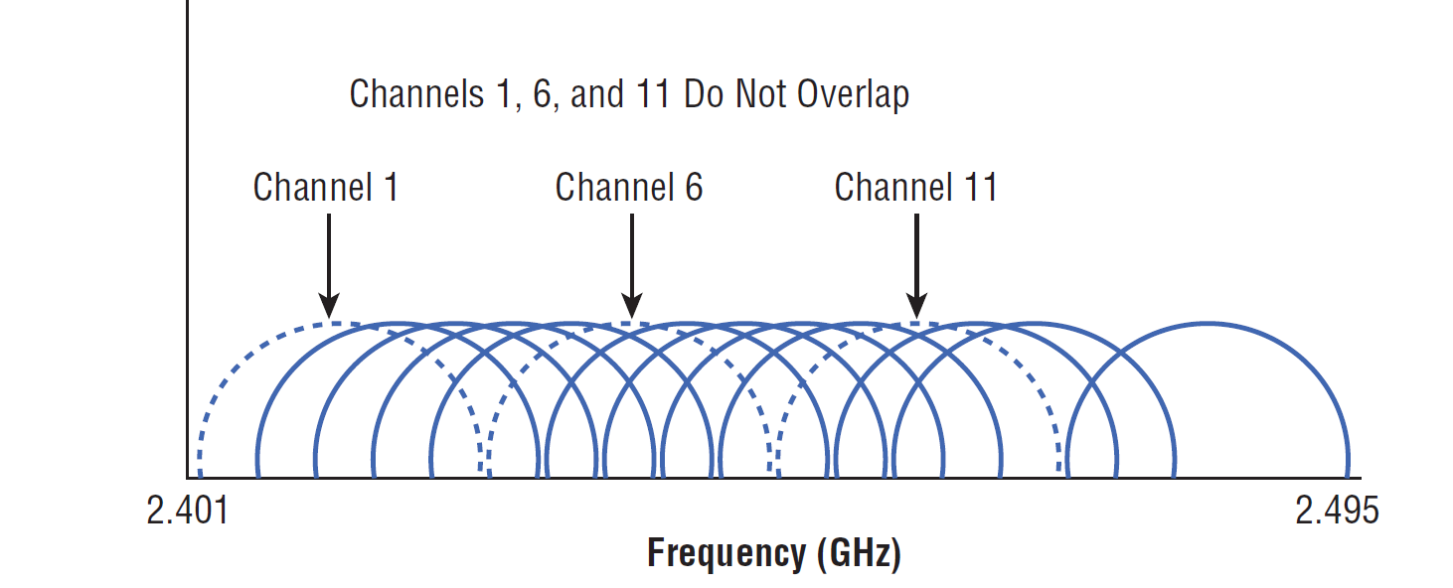
3 nonoverlapping channels possible in the 2.4 GHz
22 MHz wide
Each channel 22 MHz wide

Slide 41
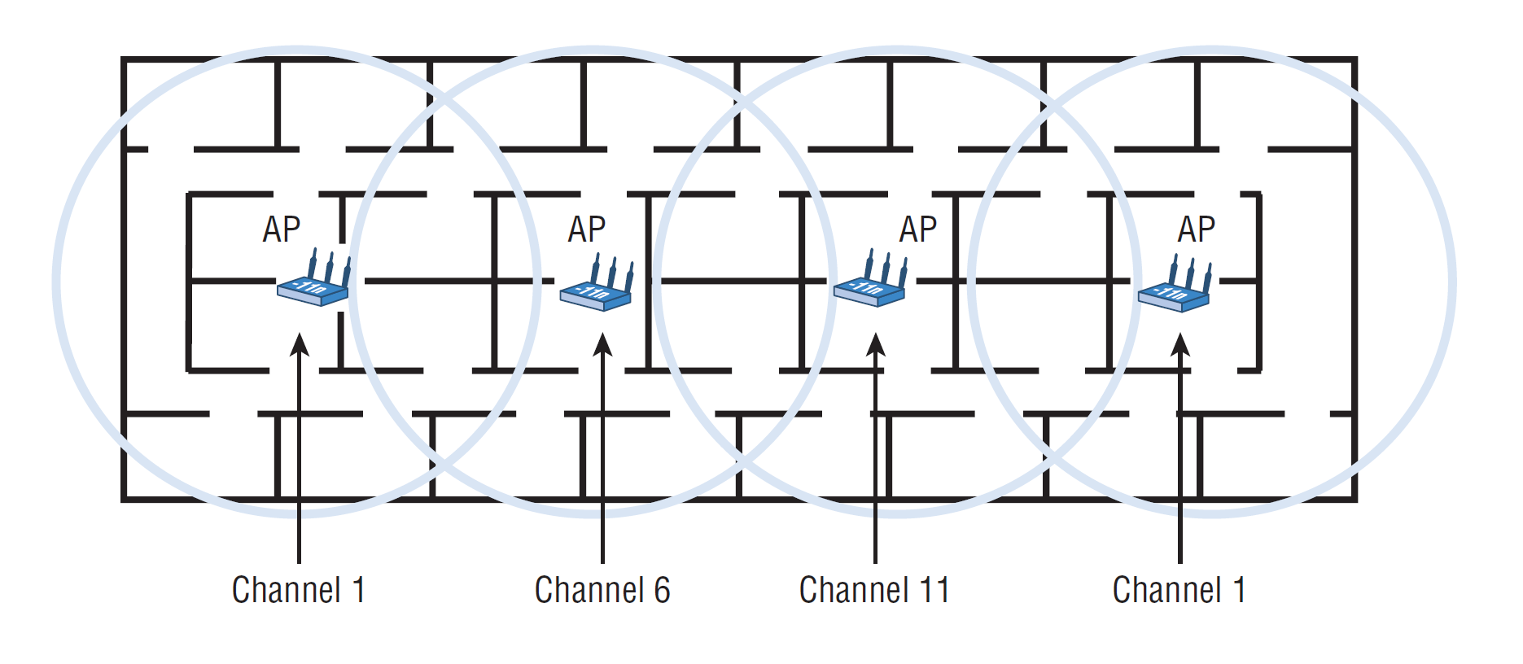
Multiple-Channel Architecture

